Slide 1
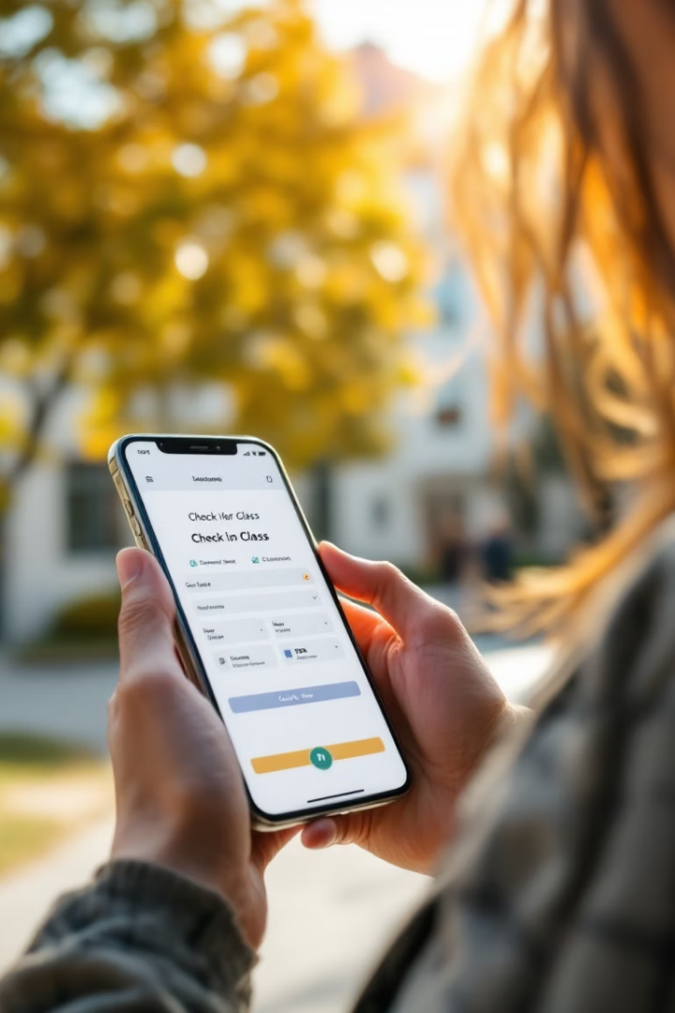
Mobile Attendance System Design: Introduction
Designing a mobile-based attendance system requires understanding user needs and environmental factors to deliver a reliable, user-centered, and secure application. A well-structured requirement gathering phase sets the foundation for all subsequent stages of system development.
This presentation outlines the critical steps and techniques involved in gathering requirements for such a system, focusing on identifying stakeholders, collecting and cleaning data, selecting methods, and evaluating user reluctance. These insights guide the development team in building a robust attendance platform.
AA
by Group 17

Slide 2



Stakeholder Identification
Students
Teachers & Staff
School Administration
Primary users who check in/out, track attendance, and receive notifications.
Use the app to take attendance, monitor participation, and generate reports.
Use the app for record-keeping, compliance, and data-driven decisions.
Stakeholders are individuals or groups who influence or are impacted by the mobile attendance system. Primary stakeholders include students, teachers, staff, school administration, developers, IT support, and local education authorities. Secondary stakeholders include alumni, community members, educational NGOs, researchers, and potential investors.

Slide 3
Requirement Gathering Techniques
Survey Forms
User Interviews
Reach a large number of stakeholders quickly, allowing for quantitative analysis and anonymity. Challenges include superficial responses and limited interaction.
Provide in-depth insights, allow for clarification, and build rapport. Challenges include being time-consuming and requiring skilled interviewers.
Requirement gathering techniques are methods used to gather qualitative and quantitative requirements from stakeholders. Techniques include survey forms (89% responses from students, 5.4% from lecturers) and user interviews (20 students, 1 lecturer/administrator interviewed).

Slide 4
Reverse Engineering & Observations
Reverse Engineering
Observations
Provides insights into current functionalities, helping to identify strengths and weaknesses of existing systems. Challenges include complexity and legal concerns.
Involves monitoring how traditional attendance is taken in lecture halls to draw conclusions and identify inefficiencies.
Reverse engineering involves deconstructing an existing application to uncover functionalities and design elements. Observations involve monitoring traditional attendance methods to identify inefficiencies.

Slide 5
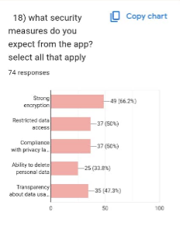

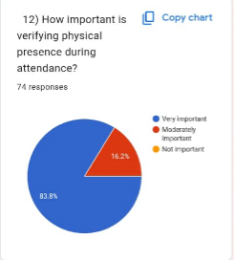
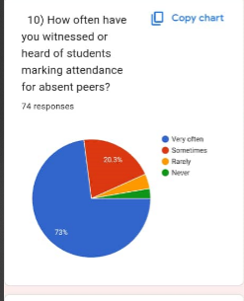
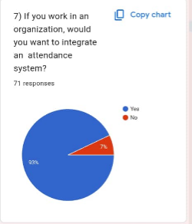
Data Gathering
Student Attendance Records
For comparative analysis.
Device Access Data
To know what platforms to support (Android, iOS).
Network Availability
Signal strength in typical classroom zones.
Survey/Interview Responses
For qualitative patterns.
Data gathering refers to the collection of actual data points needed for design, development, and validation. Examples include collecting survey results, system usage logs, class rosters, GPS data samples, or biometric image samples. Types of data collected include student attendance records, device access data, network availability, and survey/interview responses.

Slide 6
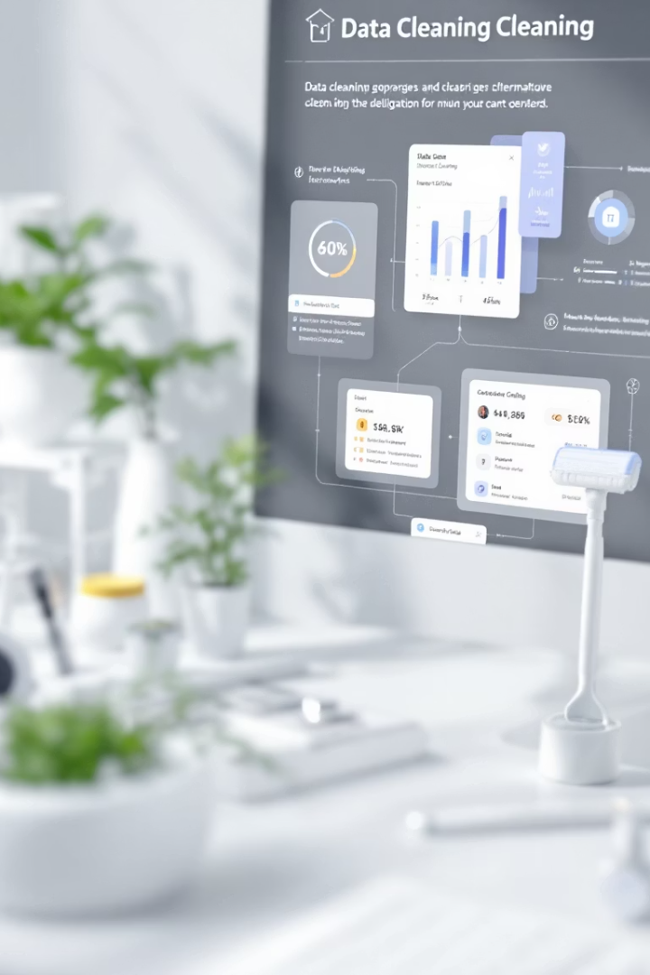
Data Cleaning
Missing Values
Duplicate Records
Incomplete data fields where information is absent.
The same record present multiple times.
Invalid Data
Entries that do not conform to expected values or formats.
Data cleaning is the process of identifying and correcting or removing inaccurate, incomplete, irrelevant, or improperly formatted data from a dataset. Common issues include missing values, duplicate records, invalid data, outliers, and inconsistent formatting.

Slide 7





Steps in the Data Cleaning Process
Data Profiling
Examine the dataset to understand its structure and issues.
Identifying Errors
Utilize statistical tools to detect discrepancies.
Handling Missing Values
Address missing data through deletion or imputation.
Correcting Inaccuracies
Identify and correct incorrect entries.
The data cleaning process includes data profiling, identifying errors, handling missing values, correcting inaccuracies, removing duplicates, standardizing formats, validating data, outlier treatment, documentation, and automation.

Slide 8
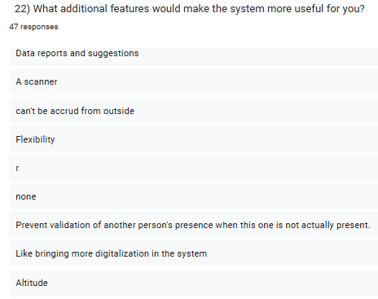
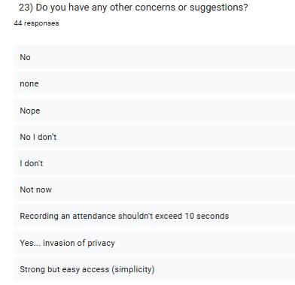
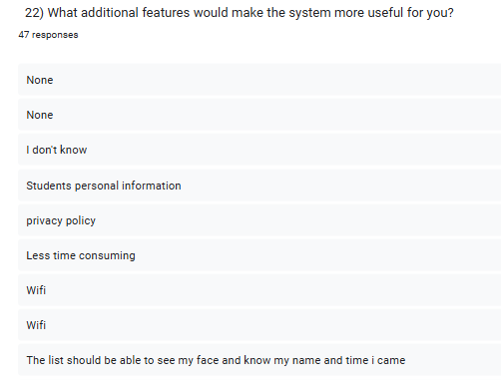
Examples

Slide 9
User Reluctance Assessment
Assessment Methods
Common Causes
Include reluctance questions in surveys.
Privacy concerns.
Hold feedback sessions.
Fear of surveillance.
Analyze behavior.
Fear of change.
Technological unfamiliarity.
User reluctance refers to the hesitation or resistance of individuals to adopt new systems. Assessment methods include reluctance questions in surveys, feedback sessions, and behavior analysis. Common causes include privacy concerns, fear of surveillance, fear of change, and technological unfamiliarity.

Slide 10
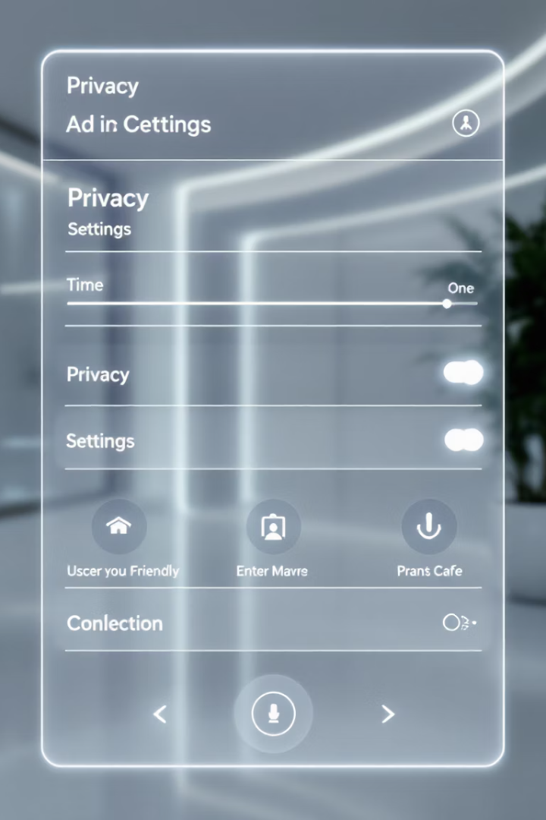
Addressing User Reluctance
Add Privacy Notices
Inform users about data usage and protection.
Allow Data Management
Enable users to see and manage their data.
Provide Education
Offer orientation videos and tutorials.
Include Manual Fallback
Offer alternative options for attendance recording.
To address user reluctance, add privacy notices and user agreements, allow users to see and manage their data, provide education/orientation videos, and include manual fallback options. Effective communication highlighting the benefits of the new system and positive reinforcement can also help.

Slide 11

Conclusion
The five components of requirement gathering are essential to designing an efficient, secure, and user-friendly mobile-based attendance system. Each step—from identifying stakeholders to assessing user reluctance—contributes to a system that aligns with real-world expectations.

